Slide 1
A PROJECT REVIEW ON EXPLORING SENTIMENT ANALYSIS ON SOCIAL MEDIA DATA BY
D. MEGHANA
B. THANUSH
J. ARCHANA REDDY
N. MANASA

Slide 2
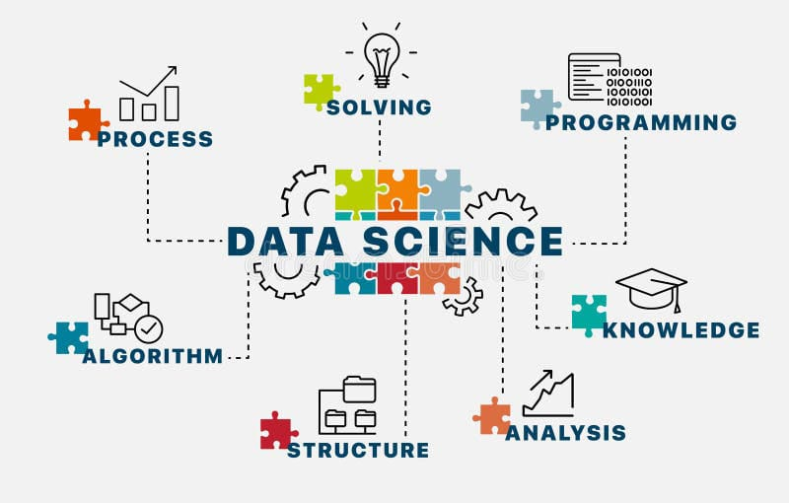
Introduction What is Data Science
Data science is a multidisciplinary field that combines various techniques, algorithms, and tools to extract insights and knowledge from structured and unstructured data. It involves the application of scientific methods, processes, and systems to analyze and interpret complex data sets, often with the goal of making data-driven decisions.

Slide 3
Objective
The goal of this sentiment analysis project on social media data is to investigate and implement effective techniques for understanding and analyzing the various emotions expressed by users across multiple social media platforms. Using advanced machine learning algorithms and natural language processing techniques, we hope to create models that can accurately capture the sentiments, opinions, and attitudes conveyed through text.
1) To detect people's mood from textual information posted on social media.
2) To classify people's sentiment based on their geographical location.

Slide 4
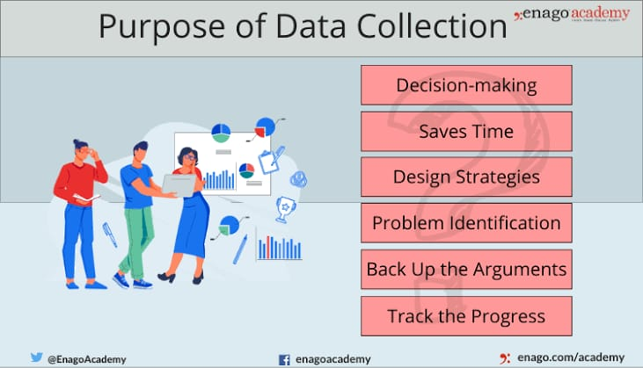
Data Collection
The process of gathering and analyzing accurate data from various sources to find answers to research problems, trends and probabilities, etc., to evaluate possible outcomes is Known as Data Collection. Knowledge is power, information is knowledge, and data is information in digitized form, at least as defined in IT.

Slide 5
Data Collection Tools
Word Association
The researcher gives the respondent a set of words and asks them what comes to mind when they hear each word.
Sentence Completion
Researchers use sentence completion to understand what kind of ideas the respondent has. This tool involves giving an incomplete sentence and seeing how the interviewee finishes it.
Role-Playing
Respondents are presented with an imaginary situation and asked how they would act or react if it was real.
In-Person Surveys
The researcher asks questions in person.
Online/Web Surveys
These surveys are easy to accomplish, but some users may be unwilling to answer truthfully, if at all.
Mobile Surveys
These surveys take advantage of the increasing proliferation of mobile technology. Mobile collection surveys rely on mobile devices like tablets or smartphones to conduct surveys via SMS or mobile apps.

Slide 6
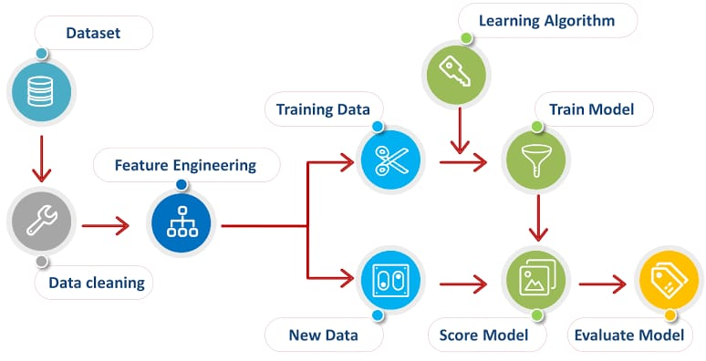
Data Preprocessing
Data preprocessing is the process of transforming raw data into an understandable format. It is also an important step in data mining as we cannot work with raw data. The quality of the data should be checked before applying machine learning or data mining algorithms.
Data Cleaning: This involves identifying and correcting errors or inconsistencies in the data, such as missing values, outliers, and duplicates. Various techniques can be used for data cleaning, such as imputation, removal, and transformation.
Data Integration: This involves combining data from multiple sources to create a unified dataset. Data integration can be challenging as it requires handling data with different formats, structures, and semantics. Techniques such as record linkage and data fusion can be used for data integration.

Slide 7
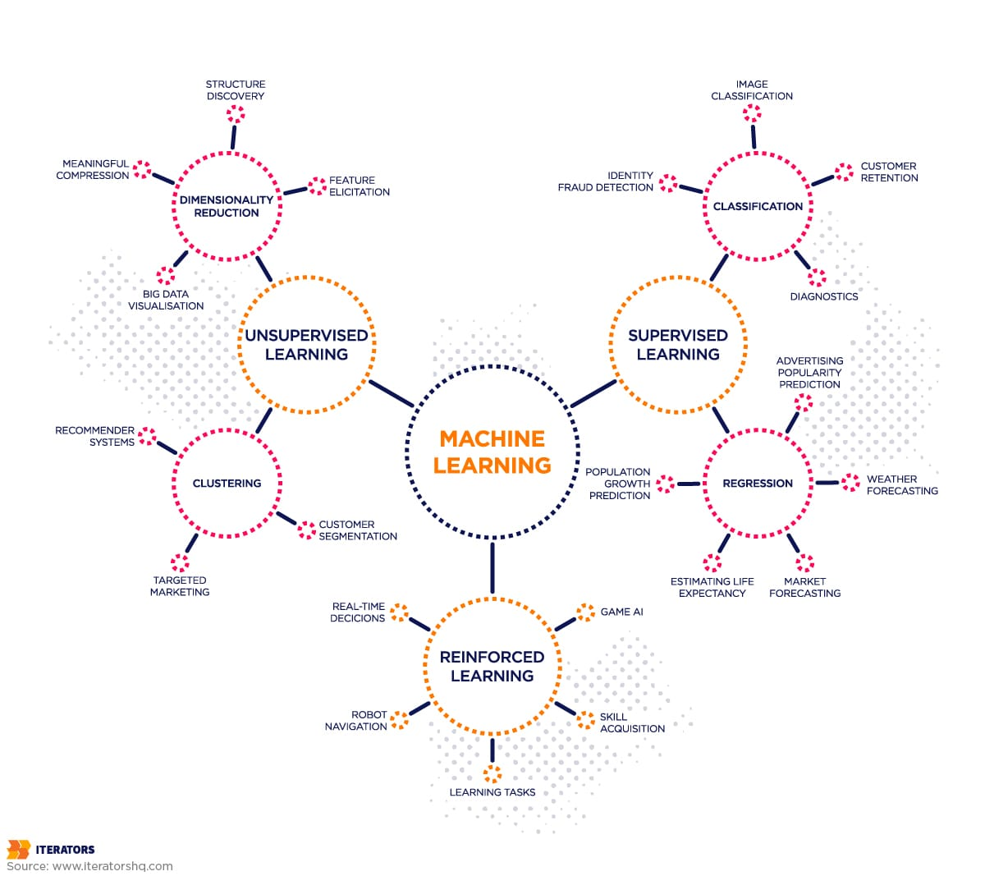
The role of Social Media Sentiment Analysis:
Social media platforms like Twitter, Facebook, YouTube, Reddit generate huge an amounts of big data that can be mined in various ways to understand trends, public sentiments and opinions. Social media data today has become relevant for branding, marketing, and business as a whole. A sentiment analysis learns about various sentiments behind a “content piece” through machine learning and predicts the same.
Machine Learning:
Machine Learning is a subset of artificial intelligence (AI) that focuses on the development of an algorithms and statistical models that enable computers to perform tasks without being explicitly programmed.

Slide 8
Data Flow Chart

Slide 9
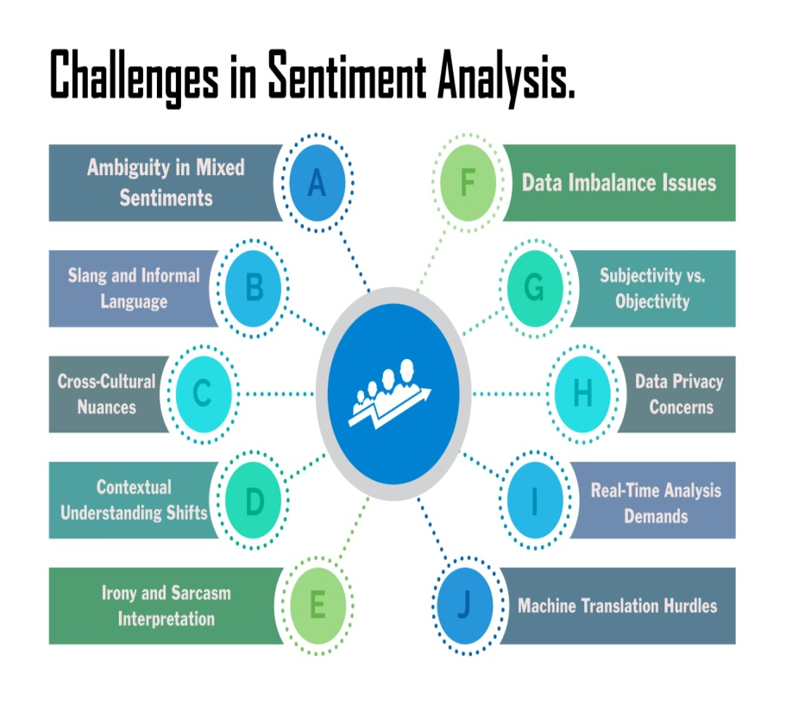
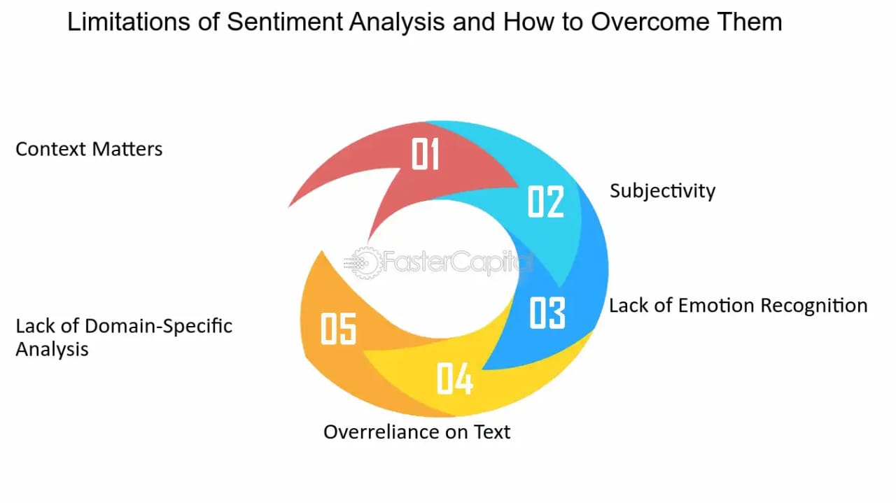
Challenges and Limitations

Slide 10
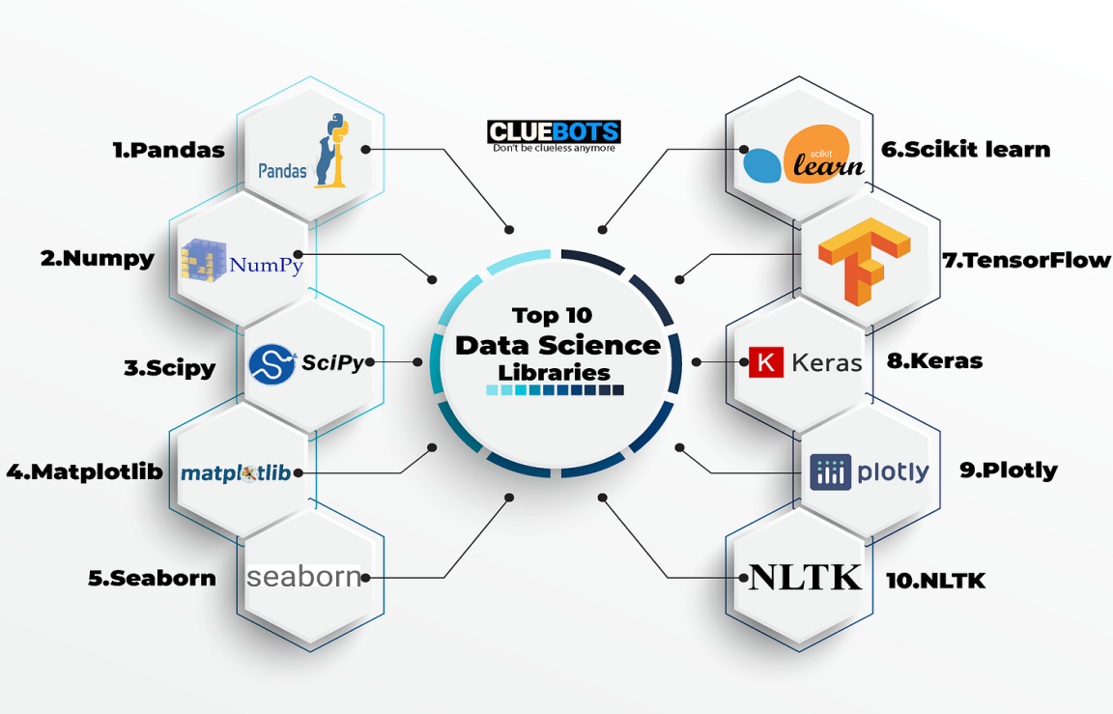
Libraries
Pandas: A library for data manipulation and analysis. It provides data structures like Data Frames and Series for handling structured data.
NumPy: A library for numerical computing in Python. It provides support for arrays, matrices, and various mathematical operations.
matplotlib: A plotting library for creating static, interactive, and animated visualizations in Python.
seaborn: A statistical data visualization library based on matplotlib. It provides a high-level interface for creating informative and attractive statistical graphics.

Slide 11
"Pip install twython" is a command to install Twython, a Python wrapper for the Twitter API. Twython is an open source library that supports Python 3 and can be used to access Twitter data. It can be used for:*Querying data for user information, Twitter lists, timelines, direct messages, and anything found in the Twitter API docs*Uploading images Updating user status with an image, Changing user avatar, Changing user background image, and Changing user banner image.
pip install vaderSentiment. VADER Sentiment Analysis : VADER (Valence Aware Dictionary and sEntiment Reasoner) is a lexicon and rule-based sentiment analysis tool that is specifically attuned to sentiments expressed in social media.

Slide 12
Algorithms
Passive Aggressive Classifier (PAC):
Passive Aggressive algorithms are online learning algorithms.
The algorithm is called "passive" because it does not significantly update the model for correct classifications, and it's called "aggressive" because it updates aggressively for misclassified instances.
Logistic Regression:
Logistic Regression is a popular classification algorithm used when the target variable is binary.
It models the probability that a given input belongs to a particular category.
Random Forest Classifier:
Random Forest is an ensemble learning method that constructs a multitude of decision trees during training.
Each tree in the forest predicts the target variable, and the final prediction is determined by aggregating the predictions of all the trees.
Support Vector Machine (SVM):
SVM is a powerful supervised learning algorithm used for classification and regression tasks.
It works by finding the hyper plane that best separates the classes in the feature space.
Multinomial Naive Bayes:
Naive Bayes classifiers are based on Bayes' theorem and assume that features are conditionally independent given the class.
Multinomial Naive Bayes is specifically designed for classification with discrete features (e.g., word counts in text classification).
It's commonly used in text classification tasks like spam filtering, sentiment analysis, and document categorization.

Slide 13
Conclusion
Sentiment analysis has proven to be a valuable tool in gauging public opinion in various disciplines, including financial market prediction, health issues, customer analytics, commercial valuation assessment, brand marketing, politics, crime prediction, and emergency management. The majority of studies have focused on sentiment analysis of Twitter messages due to the large and diverse population expressing opinions on this platform daily. This paper provides a comprehensive review of sentiment analysis in social networks, exploring methods, temporal dynamics, causal relationships, and applications in industry. The review emphasizes the importance of temporal characterization and causal effects in sentiment analysis in social networks, and their applications in different contexts such as stock market value, politics, and cyberbullying in educational centers. There is a strong interest from industry in this discipline, with over 8,000 patents issued on the topic in five years, and over 2,300 articles published in 15 years. However, there is still room for research opportunities in domains, techniques, and practical applications.

Slide 14
Queries?

Slide 15
Thank You

